Slide 1
AZ-204: Develop Compute Solutions
Sergiy nagorny
Lead consultant
7 Sep 2023

Slide 2
Overview
Part 1:
Azure IaaS Solutions
Virtual Machines
Containers
Registry (ACR)
Instances (ACI)
Part 2:
Azure App Service Web Apps
Creating
Configuring
Scaling
Part 3:
Azure Functions
Function Triggers
Input and Output Bindings
Durable Functions
Custom Handlers

Slide 3
Part 1: Provisioning and Configuring Azure Virtual Machines
VM Components
Resource Group
VM Size
Network
Images
Virtual Disk
Create VM Options
Azure Portal
Azure CLI (Demo)
Azure PowerShell
ARM Templates (Demo)
Azure REST API
Create VM in Azure Portal
Subscription
Resource Group
Name
Region
Availability (None, Zone, Set)
Image
Azure Spot instance
Size
Admin account
Inbound port rules (RDP)
Create VM Steps (Demo)
Create Resource Group
Create Virtual Machine
Enable Remote Access
Get Public IP Address

Slide 4
Understanding, Creating and Deploying ARM Templates
ARM Templates
JSON file defining resources
Building block for automation
Submitted to ARM for provisioning
Converted to REST API operations
Export from Azure Portal, Azure CLI, etc.
Deploy from Azure Portal, Azure CLI, etc.
Custom template (Demo)
Quickstart Template Library
ARM Template Format
"$schema": "https://schema.management.azure.com/schemas/2019-04-01/.deploymentTemplate.json#",
"contentVersion": "", // For user version control
"apiProfile": "", // For versioning resources in template
"parameters": { }, // Deployment values
"variables": { }, // Values reused in the template. Constructed from parameters
"functions": [ ], // Simplify template and allow code reuse
"resources": [ ], // Resources to be deployed
"outputs": { } // Return values from resources deployed
"dependsOn": [ ] // List of resources to be created before current resource.
"properties": { } // Resource properties

Slide 5
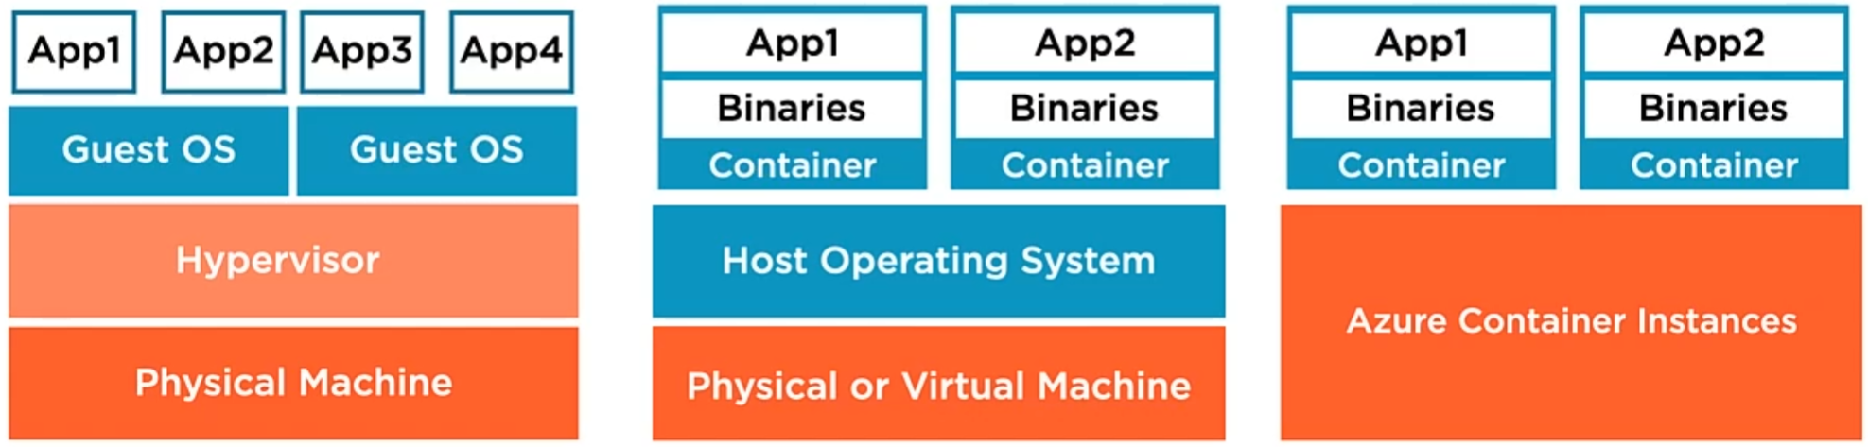
Creating and Running Containers in Azure
Container Fundamentals
Binaries, libraries and other components
Container image – binary application package
Container – running container image
One app inside the container
Generally, very small and very portable
Dramatically simplifies app deployment (start container)
Focus on Apps (build, configure, deploy)
Apps communicate via network
Tools and Services
Docker – Tools to create container
Azure Container Registry (ACR) – Store and manage containers
Azure Container Instances (ACI) – Run container with no Servers to manage
Compute PaaS (VM, OS)

Slide 6
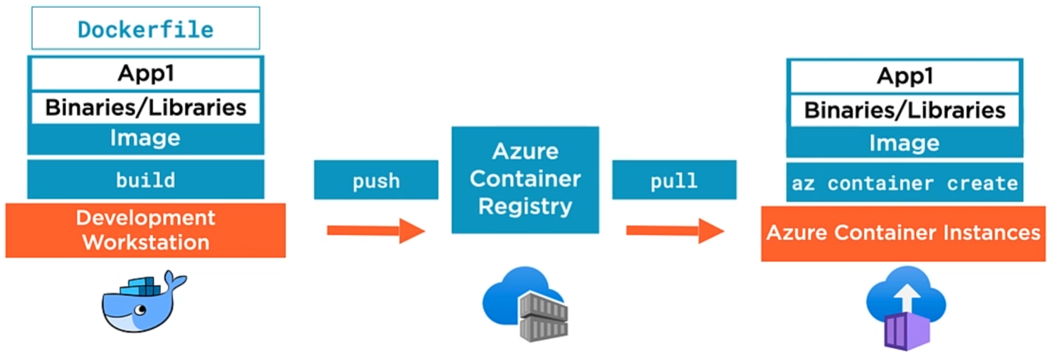
Creating and Running Containers in Azure
Build new image (Demo)
Development workstation
Docker tools
Dockerfile
Sequence of commands used to build a Container Image
Copy compiled App binaries into Container Image
Define with binary scripts to run when container is started from image
Push to ACR (Demo)
Upload container image
Share with:
Other users
Container orchestrators
Key component in a CI/CD pipeline
ACR Tasks for container image automation
Service tiers (Basic, Standard, Premium)
Pull from ACR (Demo)
Download container image
Create running container in ACI
Default: 1 vCPU, 1 GB RAM
Access Apps over internet via automatically provisioned FQDN
Optionally connect Apps to VNET (combine with ExpressRoute or VPN Gateway)
Use Azure Files for persistent storage (mounted File Shares backed by Azure Storage)
Define Restart policy - always, on failure and never
ACI is most affective for simple Apps, Task Automation, Build Jobs
Deployed in Groups (Share Host Machine, LAN, Storage and Lifecycle)
Combine Main App Container with Supporting Containers (e.g. Logging) to construct complex Apps
For Full Container orchestration use Azure Kubernetes Service

Slide 7
Part 2: Creating Azure App Service Web Apps
Azure App Service
Http-based service for hosting web apps
Advanced version of web posting
Apps run and scale on Windows and Linux
Web app frameworks: AspNet, AspNetCore, NodeJs, Python, Php, etc.
Security, load balancing & automation
App Service web app runs under App Service Plan
VMs are behind App Service Plan
Managed by Microsoft in terms of patching, high availability, security, etc.
Costs use are determined by the App Service Plan
Two App Service Plan Types
Non-Isolated
Isolated
Non-Isolated Plan
Users access Web App over internet
Does NOT run in private VNET
Free and Shared Plans (F1, D1)
Run in shared infra with other customers and low spec resources
Not suitable for Prod (not secure or scalable enough)
Basic (B1, B2, B3)
Low traffic requirements
Don’t need advanced auto scaling or traffic management features
For more robust Dev and Test scenarios
Standard (S1, S2, S3)
For Production workloads
Pricing based on number of instances running
Start with S1 and scale-up as needed
Premium v2/v3 (P1v2 - P3v3)
Enhanced performance for Production web apps
Isolation with App Service Environments (ASE)
Fully isolated and dedicated environment for running web apps
Still managed but dedicated to you to make part of private VNET
Designed for high performance, scale, high memory utilization (if Non-Isolated isn’t enough for Production)
Isolation and secure network access
Fine-grained control over network traffic (i.e. Network Security Groups)
Apps can connect over VPN to on-premises resources
On-premises Apps can communicate with your Web App running in ASE

Slide 8
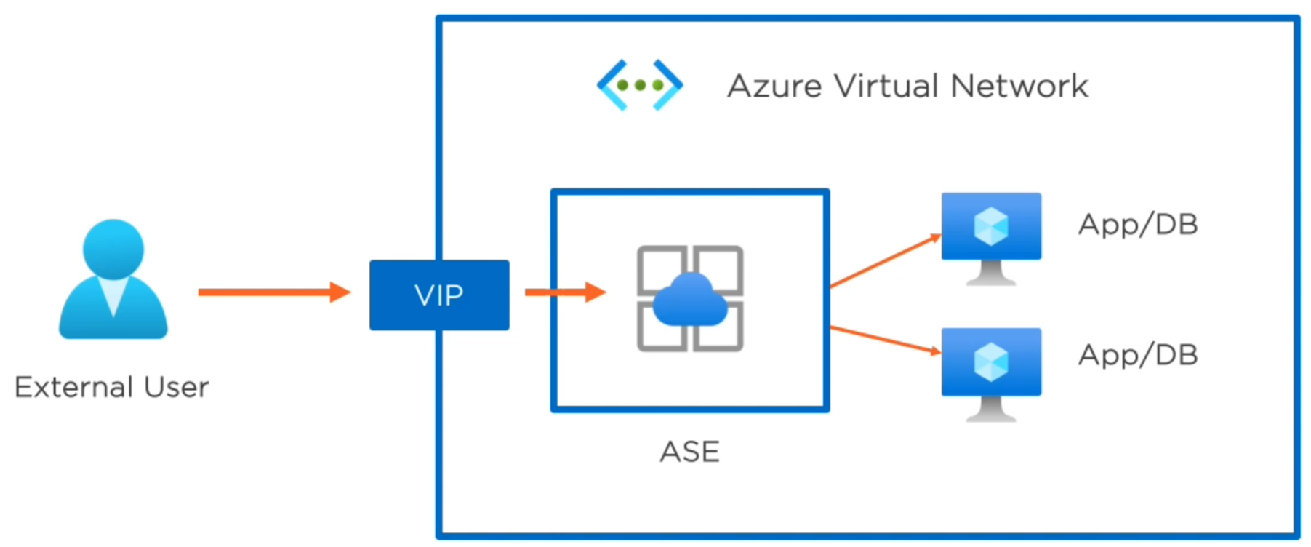
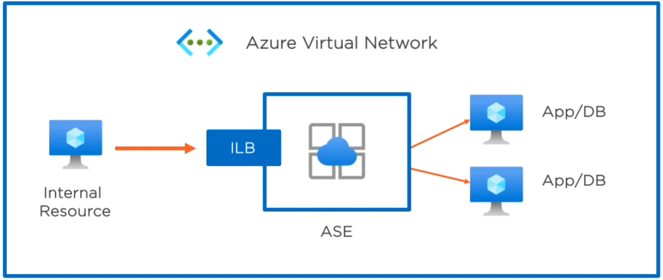
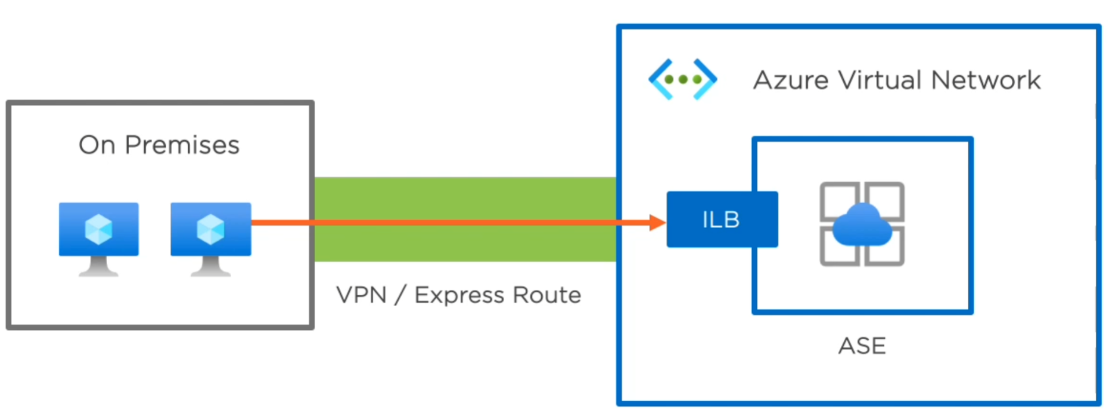
Creating Azure App Service Web Apps
External ASE Model
All resources may NOT have Public IP
Network access explicitly allowed to outside world
External Users access ASE via Public Virtual IP (VIP) address
Internal ASE Model (two diagrams below)
Internal Resources access ASE via Inside Load Balancer (ILB) Private IP address resource
Common Pattern: On-Premises servers talk to ILB Private IP address over a private connection (i.e. VPN, Express Route)

Slide 9
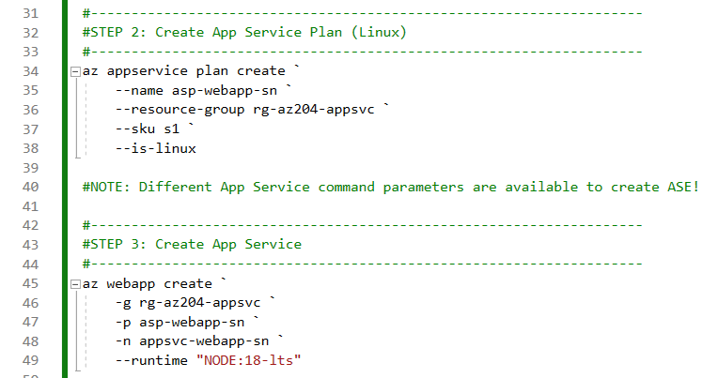
Creating Azure App Service Web Apps
Creating Web App via Azure CLI (Demo)
Creating Web App in Azure Portal
Subscription
Resource Group
Name = [unique].azurewebsites.net
Publish = Code, Docker Container
Runtime stack = .NET Core 6 LTS, ASP.NET 4.8, Java
Docker Operating System = Windows, Linux
Region = Australia East
App Service Plan
Windows Plan = (New) ASP-webappsdevrg-b843
Sku and size = Standard S1, 100 total ACU, 1.75 GB memory
Monitoring
Enable App Insights = Yes
App Insights = (New) appinsights123 (Australia East)
Test created Web App by browsing URL from Overview page

Slide 10
Configuring Azure App Service
Options
Securing a Web App with SSL
Configuring a Database Connection String (see script)
Enabling Diagnostic Logging
Deploying Code to App Service Web Apps
Secure a Domain with SSL/TLS Binding
External user > http/https > [name123.azurewebsite.net > App Service Web App]
By default SSL certificate is provided over HTTPS for *.azurewebsites.net
Custom domain (e.g. pluralsight.com) can be configured instead to resolve to our web app
Considerations:
Use Basic, Standard, Premium or Isolated plan types
Public vs. private certificates:
Can purchase private cert from known CA (e.g. VeriSign)
Can generate own private cert from own CA
Client will likely trust cert from known CA
Managed vs. un-managed certificates:
Managed = Purchased in Azure Portal (i.e. App Service Cert)
Un-managed = Generated with own tool or purchased from commercial vendor and uploaded
You can enforce HTTPS and TLS versions (disable HTTP)

Slide 11
Configuring Azure App Service
Deploying code to App Service Web Apps
Using native capability
Configuring Continuous Deployment (CD):
Change to code updates App Service
App Service pulls code from GitHub, Bitbucket, and Azure Repos
Associate App Service with specific Repo branch
Deployment occurs any time a branch is updated
Continuous delivery = More checks along the way
Authorize Azure App Service to retrieve repo code
Enable/disable continuous deployment on App Service
Enabling Diagnostic Logging
Important for Production to monitor for performance issues and errors
Application logging
For Windows/Linux app services. Log messages generated by our app code, using a specific web framework (e.g. DotNetCore, NodeJs, etc).
Messages are assigned to different categories / log levels (e.g. Critical, Error, Warning, Info)
Can be stored on file system of app service or Azure Storage account
Web server logging
Specific to Windows. Logs raw HTTP requests made, Method used, Client IP, etc. Standard web server logs.
Can be stored on app service file system or Azure Storage account
Detailed error messages
Specific to Windows. Prevent showing detailed error messages to users. Can be enabled for Dev only.
Turned off by default (avoid exposing sensitive error info)
Failed request tracing
Specific to Windows. Provides detailed information on failed HTTP requests and IIS components used & time taken by each.
Deployment logging
For Windows/Linux. Logs from pushing code to your App Service. Useful to reverse engineer errors during deployments.

Slide 12
Scaling Azure App Service
Overview
Vertical and horizontal scaling
Manually scaling App Service
Scale on a schedule
Implementing auto-scaling in App Service
Scaling Up Vertically
Can be done if over time a VM needs more CPU and RAM resources
Go to service Properties > select Scale-up > changes should take effect after small outage
App Service Plans are powered by VMs
Example 1:
VM (Standard_A1_v2, 1 vCore, 2 GB RAM)
scale-up to
VM (Standard_A8m_v2, 8 vCore, 64 GB RAM)
Example 2:
VM (Standard S1, 1 CPU Core, 1.75 GB RAM) scale-up to
VM (Standard S3, 4 CPU Core, 7 GB RAM)
Scaling Out Horizontally
If manual hosting
Azure Load balancer > VM x2
App Service Plan works in the same way
Implicit Load balancer > VM x2
Scale Out rules
Auto: Average CPU > 70% for 5 min
Auto-scale event is triggered to add a 3rd VM
Schedule: 9:00 AM - 3 Instances
For predictable requirements
Scale In rules
Auto: Average CPU < 20% for 5 min
Schedule: 5:00 PM - 2 Instances
Great way to control our costs and provide required resources to meet user demands
Auto-scale is available for Standard, Premium, and Isolated pricing tiers

Slide 13
Scaling Azure App Service
Manual Scaling
Azure Portal > Resource group > App Service > Settings
Scale up (App Service plan)
Scale out (App Service plan)
Scale up
Production (S1, P1V2, P3V3, etc.)
See additional options for included features (e.g. Max 10 of supported auto-scale instances)
Scale out
Choose how to scale your resource > select "Manual scale"
Manual scale > Instance count > 1, 2, 4, etc.
Implicit Load balancer is used in background
Check Overview tab > note instance count under App Service Plan:
ASP-webappsdevrg-9abc (S1: 2)
Scaling on a Schedule
If resource requirements are known
Azure Portal > App Service > Settings > Scale out (App Service Plan)
Select "Custom autoscale" > Delete default rule > Add new scale condition (#1):
Scale to a specific instance count = Yes
Instance count = 4
Schedule = Repeat specific days
Repeat every = Mon, Tue, Wed, Thu, Fri
Timezone = (UTC 07:00) Mountain Time (US & Canada)
Start time = 06:00
End time = 17:00
Add new scale condition (#2):
Instance count = 2
This scale condition is executed when none of the other scale condition(s) match

Slide 14
Part 3: Creating Azure Functions
Choices
Programming Languages
C#, Java, JavaScript, Python, PowerShell, other
C# and JavaScript are most common
Hosting: Run in a "Service plan" on Azure App Service
Consumption Plan
Serverless
Bills only when function is running
Automatic scaling
Most commonly used
Limitation: 5 min limit on invocation
App Service Plan
No time limit
Traditional pricing model - Pay monthly for compute resources reserved
Premium Plan
Speed (faster performance)
Security (enhanced security)
Reserved instances (always ready to run)
Serverless automatic scaling capability
Other options
Run in Docker container
Can run on-premises
Can run in any cloud provider
Run locally
For development and testing
Dev Environment Options
Directly in Azure Portal
Good for learning and experiments
Visual Studio 2019+
For most applications
Good for C# and running on Windows
Azure Functions Core Tools
Cross-platform CLI
Use together with a code editor with Visual Studio Code
Azure Functions
A "serverless application platform"
A simple way to run small piece of code ("functions") in the cloud
A "Functions as a Service" (FaaS) platform
Azure Function App
One or more related Azure Functions, developed, deployed and hosted as a group
Generally requires a Storage Account (dependency resource)
Serverless
Delegate server management responsibility to the cloud provider
Developers focus on code
Automatic scaling to meet demand
Billed only while your code is running

Slide 15
Implementing Azure Function Triggers
Azure Function Triggers
Trigger - what causes the Function to be executed
Objective: "implement function triggers using data operations, timers and webhooks“
Every Function has exactly one trigger
Trigger is the event that causes function to run
Common Trigger Types
HTTP Request - Use for REST APIs and webhooks
Timer - Use for scheduled tasks
Data Operation:
Queue - Run in a response to a message on a queue (i.e. Storage, Service Bus)
Cosmos DB - Run when document is created or updated
Blob - Run when new file is uploaded to Blob Storage
Many Other Trigger Types
Event Grid, Microsoft Graph, etc.
HTTP Request Trigger
Most commonly used
Implement APIs or respond to webhooks from external system
Customization
HTTP methods - e.g. GET or POST
Route - Control Function URL
Secured via authorization key
Anonymous - No Key required
Function - Key per Function
Admin - Key per Function App
Timer Trigger
Simple but powerful way to run scheduled tasks in the cloud
CRON expression
Determines when function should run

Slide 16
Implementing Azure Function Bindings
Azure Function Bindings
A binding is a connection to data
Binding is optional and can be Input or Output
Input Bindings
Provide read-access to data
Get data into our functions from external systems
Output Bindings
Let us write to an external system
Send messages, add document to a database
Functions can have multiple input and output bindings
function.json - defines all triggers and bindings used by an Azure Function
Every Azure Function has its own function.json file
Input Binding Types
Blob Storage binding - read contents of a file in Blob Storage
Cosmos DB binding - look up a document in a Cosmos DB
Microsoft Graph binding - access OneDrive
Output Binding Types
Blob storage binding - Create a new file in Blob Storage
Queue Storage binding - Post a message to a queue
Cosmos DB binding - Create a new document in a database
Many others:
Event Hub, Service Bus, SendGrid, Twilio, etc.
SendGrid - Third party for sending emails
Twilio - Third party for sending SMS

Slide 17
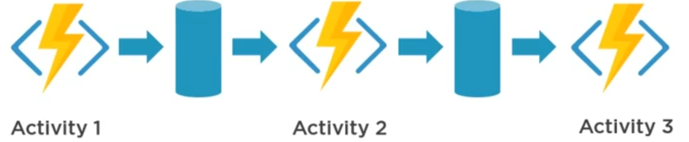
Implementing Azure Durable Functions
Orchestration Patterns
Azure Durable Functions
An extension to Azure Functions
Recommended to use C# or JavaScript
Create stateful, serverless workflows ("orchestrations")
3 Types of Function:
1. Client ("Starter") Function
Initiate a new orchestration
Use any trigger
2. Orchestrator Function
Defines the steps in the workflow
Handle errors at any point
Doesn't perform any actual steps
Contains multiple activities, performed in sequence or parallel
Has to follow strict guidelines
3. Activity Function
Implements a step in the workflow
Use any bindings
Function Chaining
Execute sequence of activity functions in specified order
Orchestration function keeps track of where we are in the sequence

Slide 18
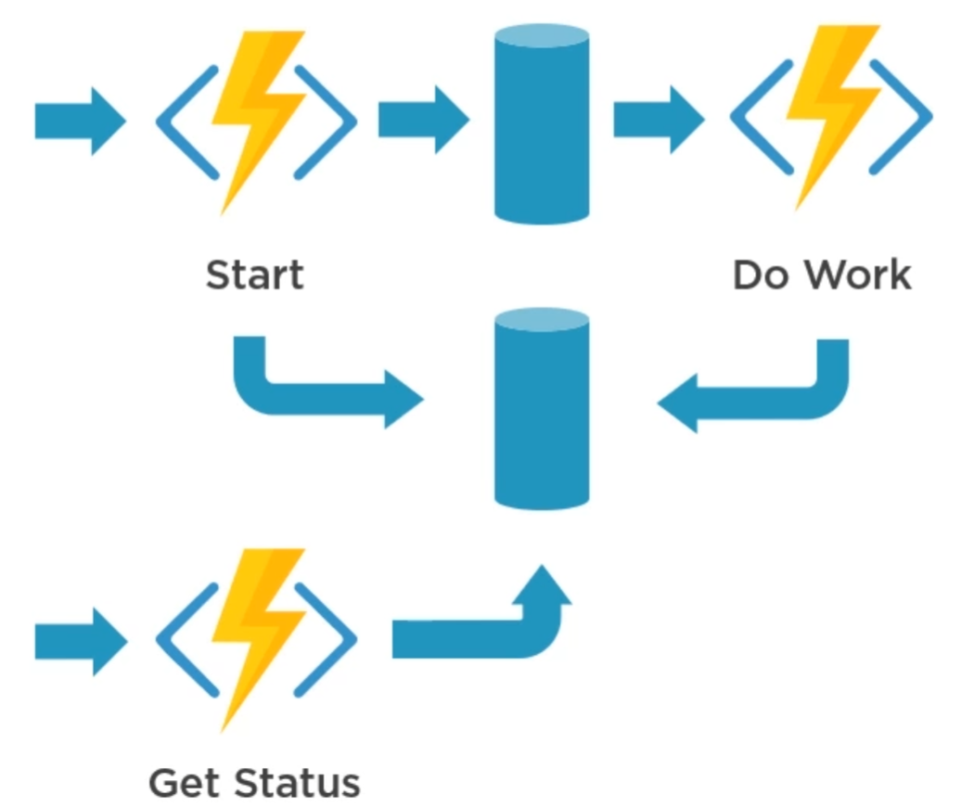
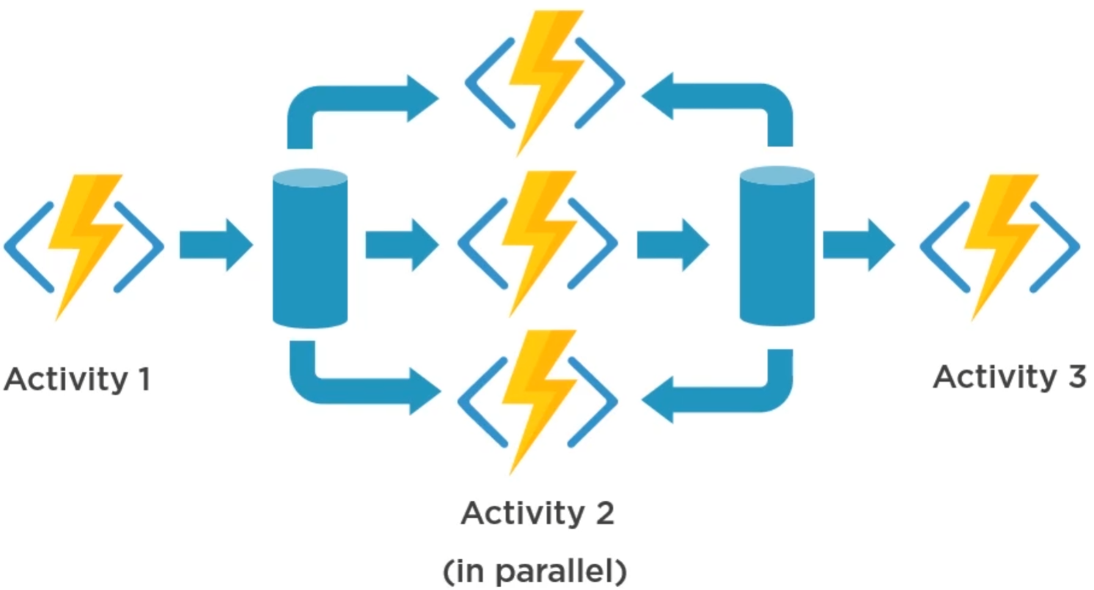
Implementing Azure Durable Functions
Orchestration Patterns (cont.)
Asynchronous HTTP APIs
Fan-out Fan-in
Waits for all parallel Activities 2 to finish
Results can be aggregated to compute final result
Hard to achieve otherwise without Durable Functions
Useful when you have an API that needs to be repeatedly polled for progress
Start off a long running operation
Orchestrator function can manage the polling until operation completed or timed out

Slide 19
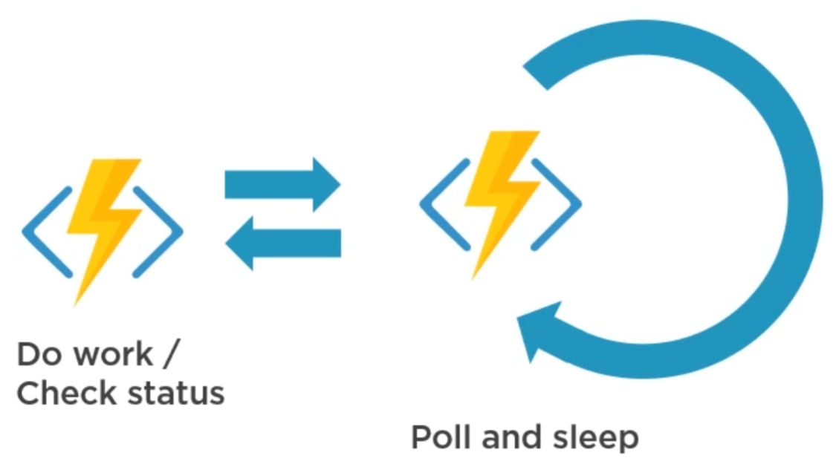
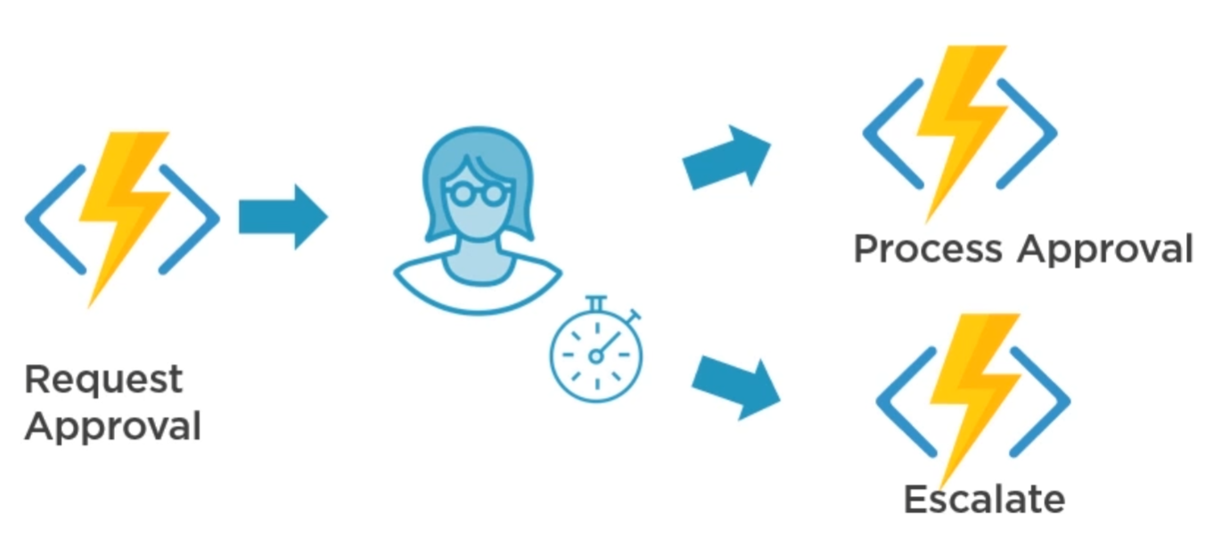
Implementing Azure Durable Functions
Orchestration Patterns (cont.)
Monitor
Human Interaction
Look for a change in state
Can be used to repeatedly call an Activity Function and checking to see if certain conditions are met
Waits for certain events to be raised
Optionally perform a mitigating action on timeout waiting for a person to respond

Slide 20
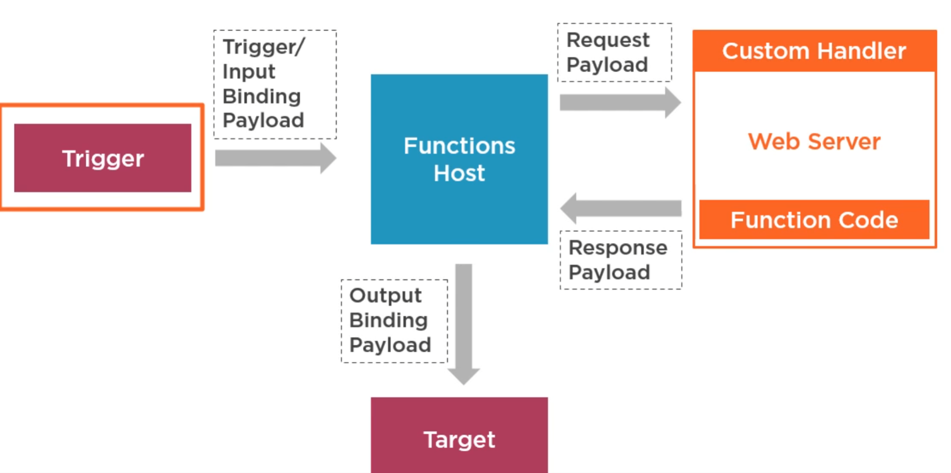
Implementing Custom Handlers
Custom Handlers
Can be used to implement functions in unsupported Programming Language and Runtime (e.g. Rust or Go)
Won’t often be necessary, but a useful option to be aware of
Function Host makes an ongoing HTTP Request to a Web Server running your custom handler code
Input Binding data is forwarded as Request Payload
Custom handler can return data to Function Host as Response Payload
The data is forwarded to Output Binding (if configured)

